Slide 1
s-SNOM Measurements
October 30, 2017
Bowtie and Discrete Bowtie antennas
Under linear polarization

Slide 2
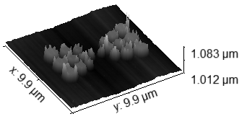
Illumination conditions
Z
E_{i}
Incident wave θ = 60º
Light: linear polarization
Incidence: p-polarization (k and E vectors are in the YZ plane)
Structure A4
Y
θ
k-vector
X

Slide 3
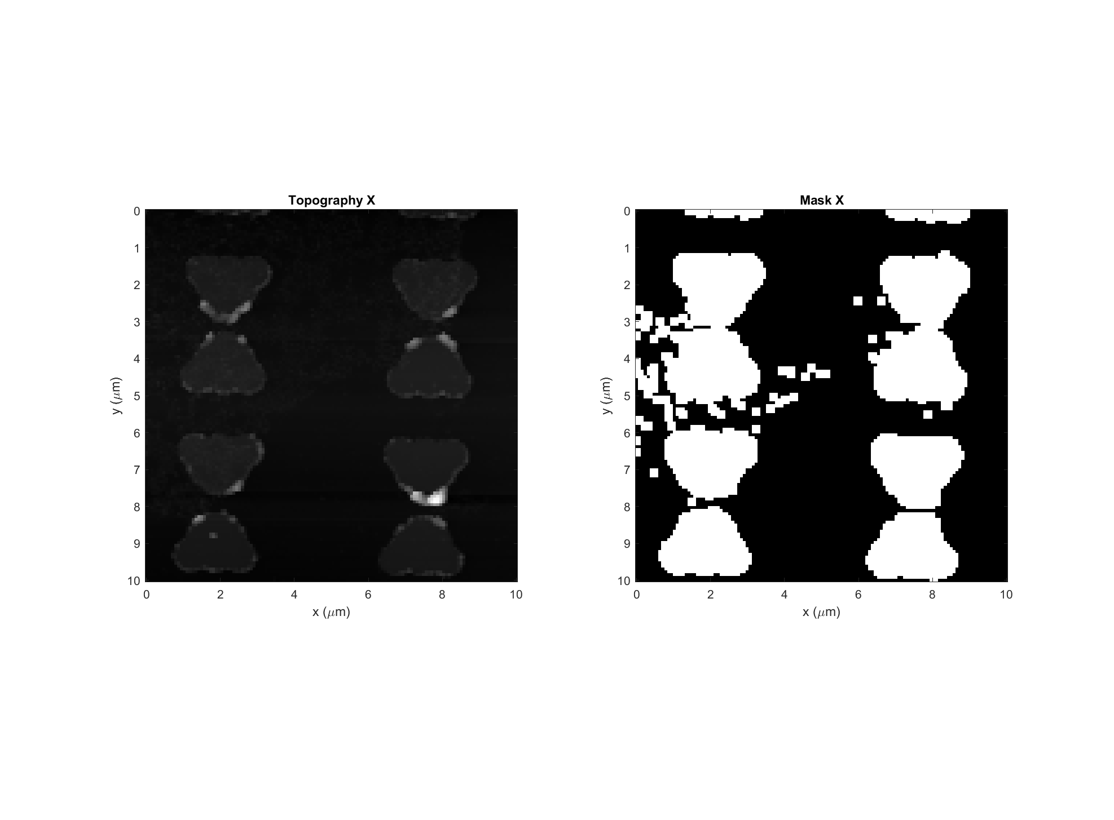
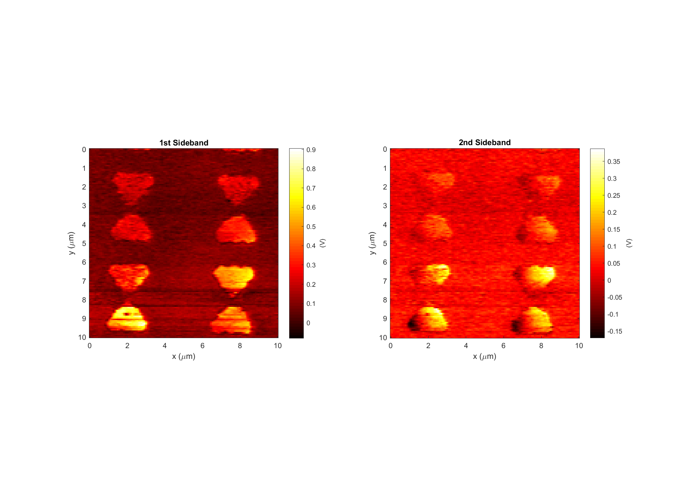
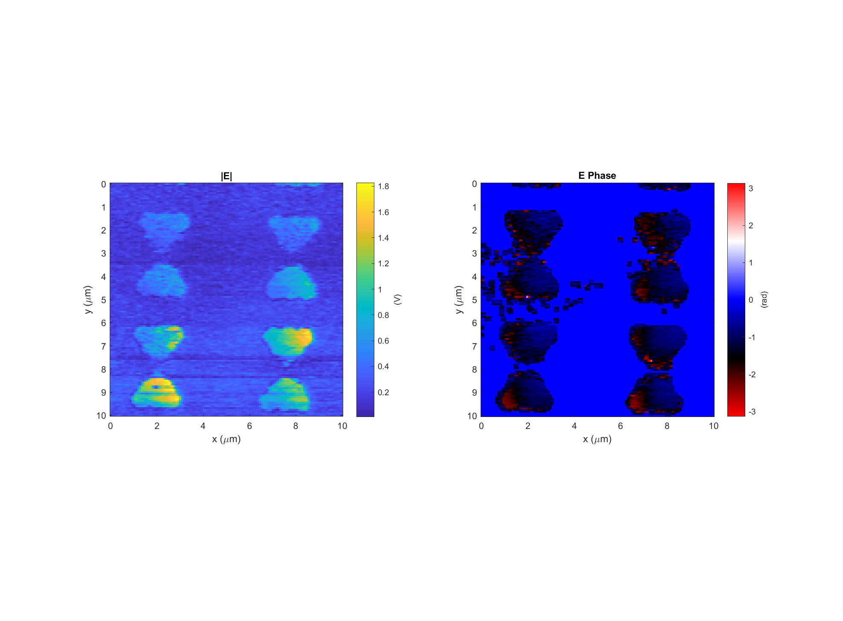
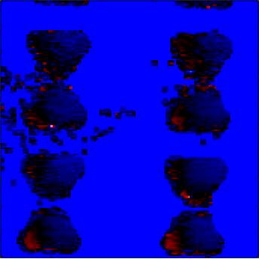
Bowtie Data: 2017-10-30_bowtie_1_p-pol_PH_X_2
k
Light incident from below

Slide 4
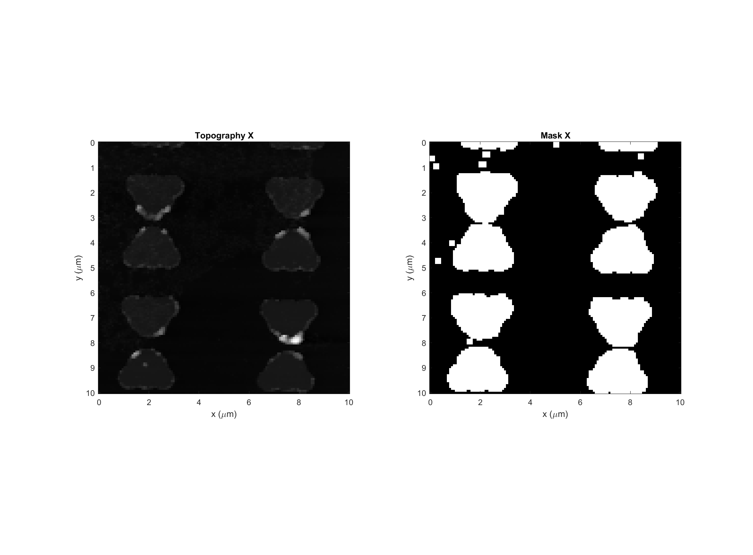
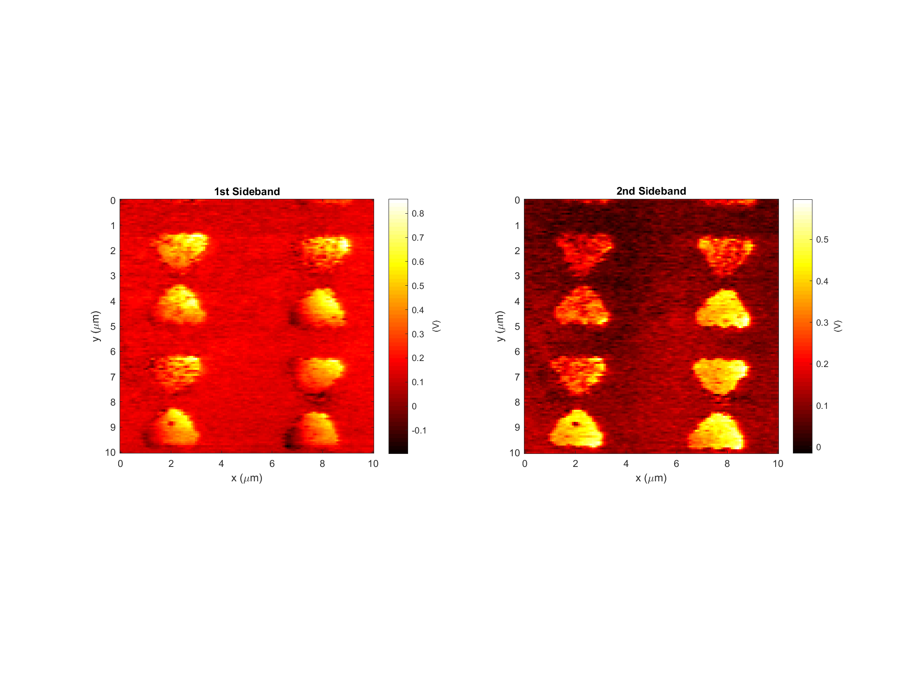
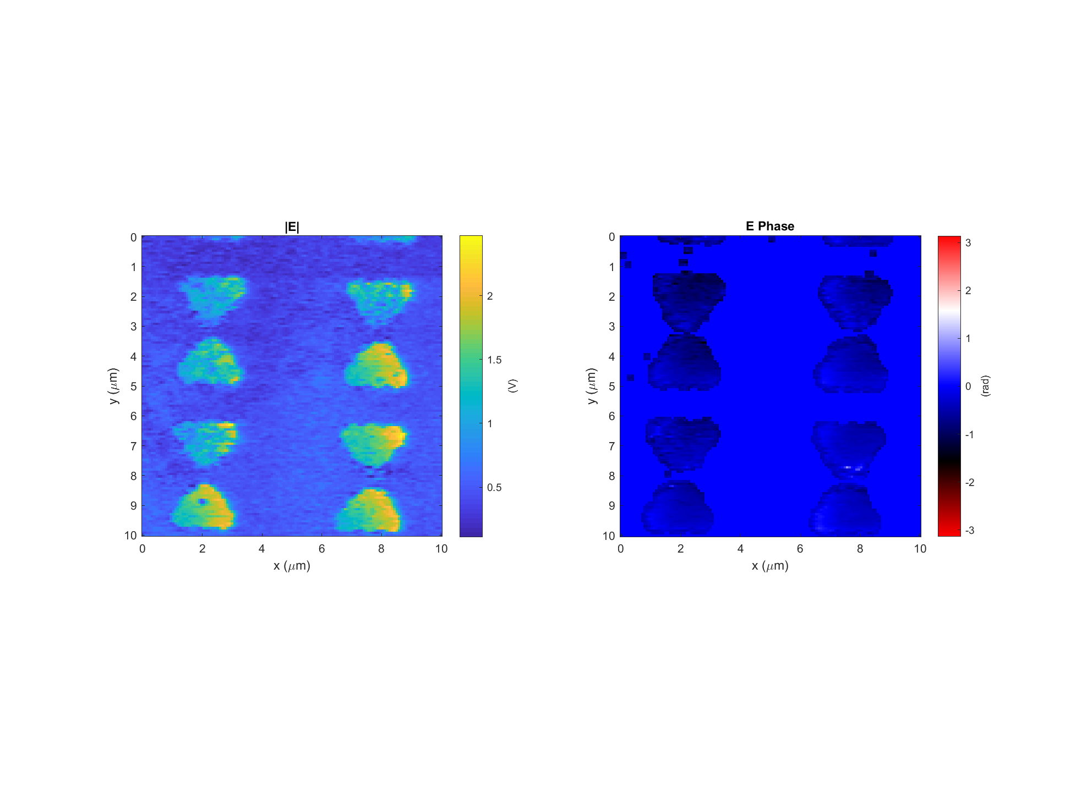
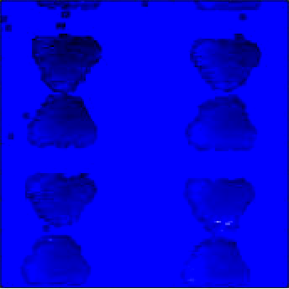
Bowtie Data: 2017-10-30_bowtie_1_p-pol_PH_X_3
k
Light incident from below

Slide 5
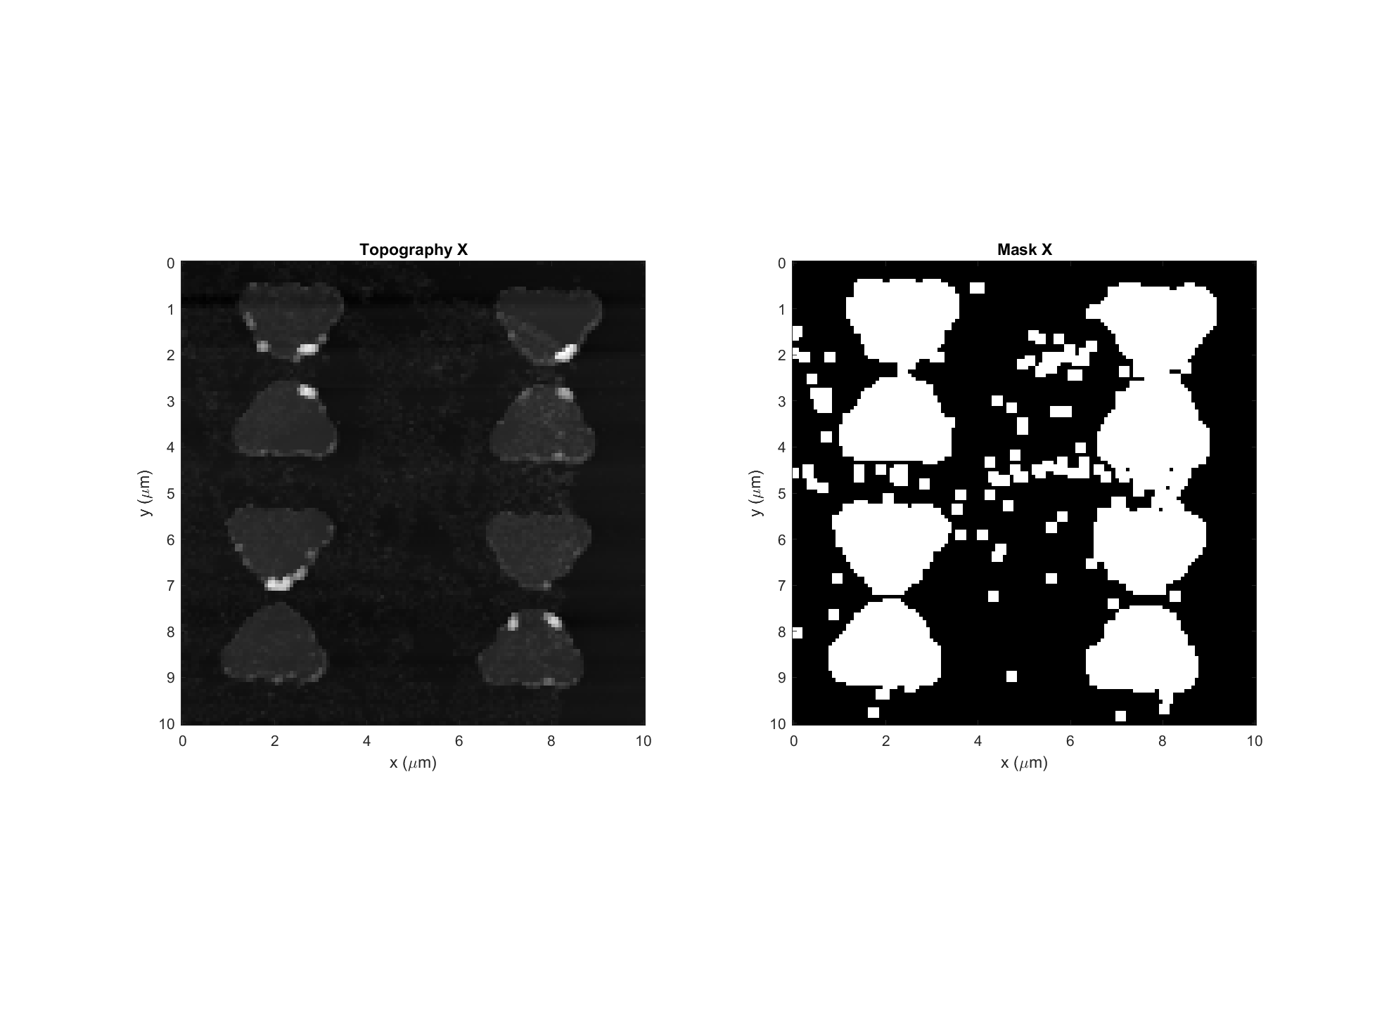
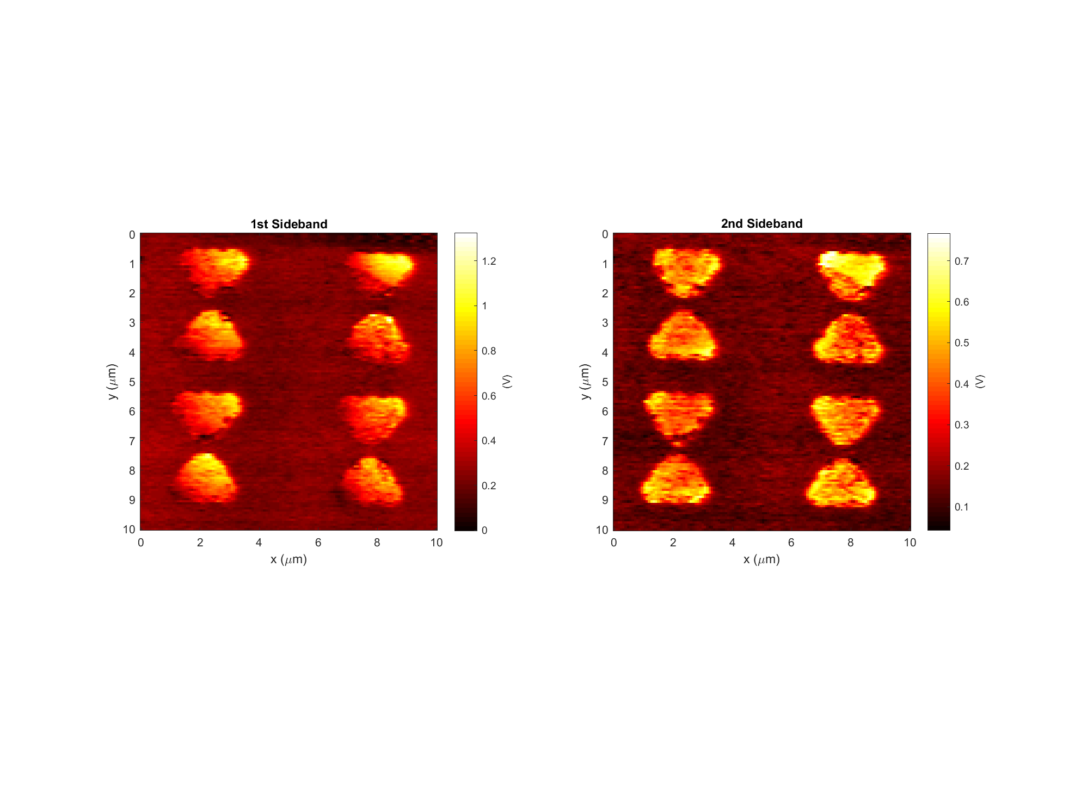
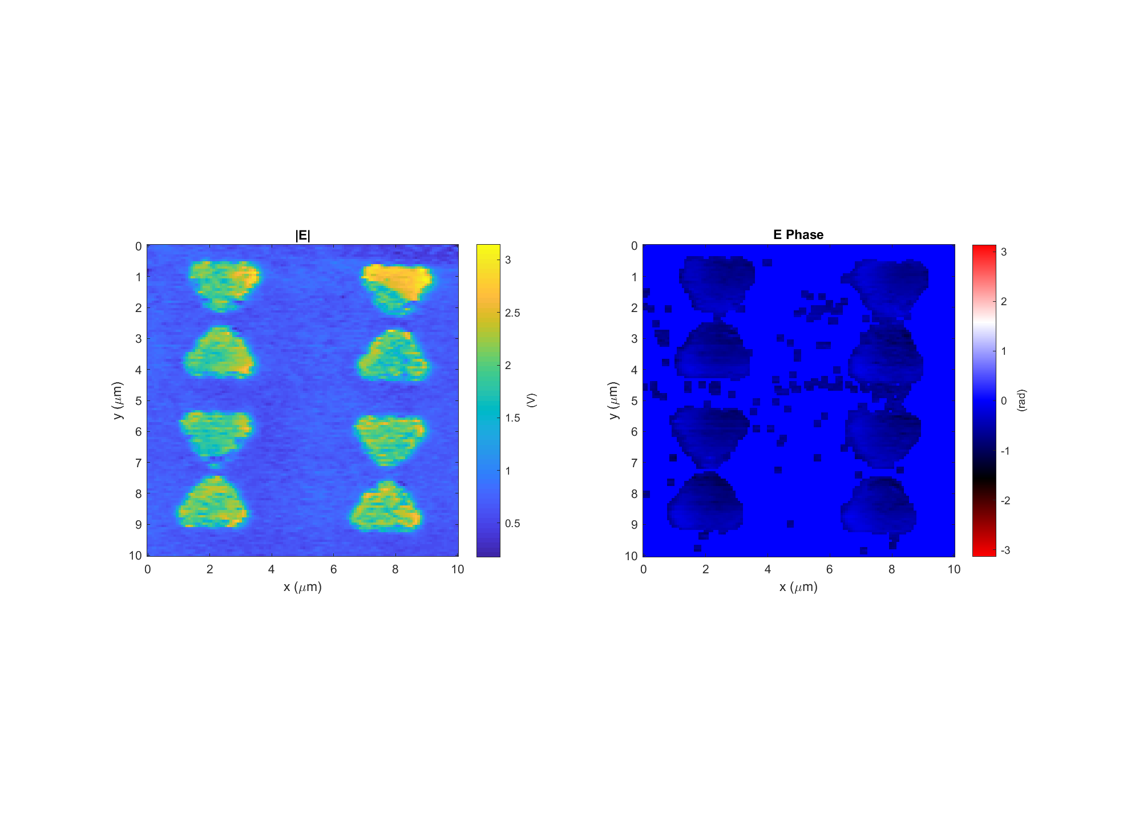
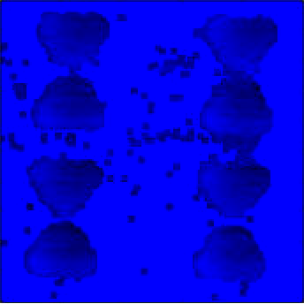
Bowtie Data: 2017-10-30_bowtie_1_p-pol_PH_X_5
k
Light incident from below

Slide 6
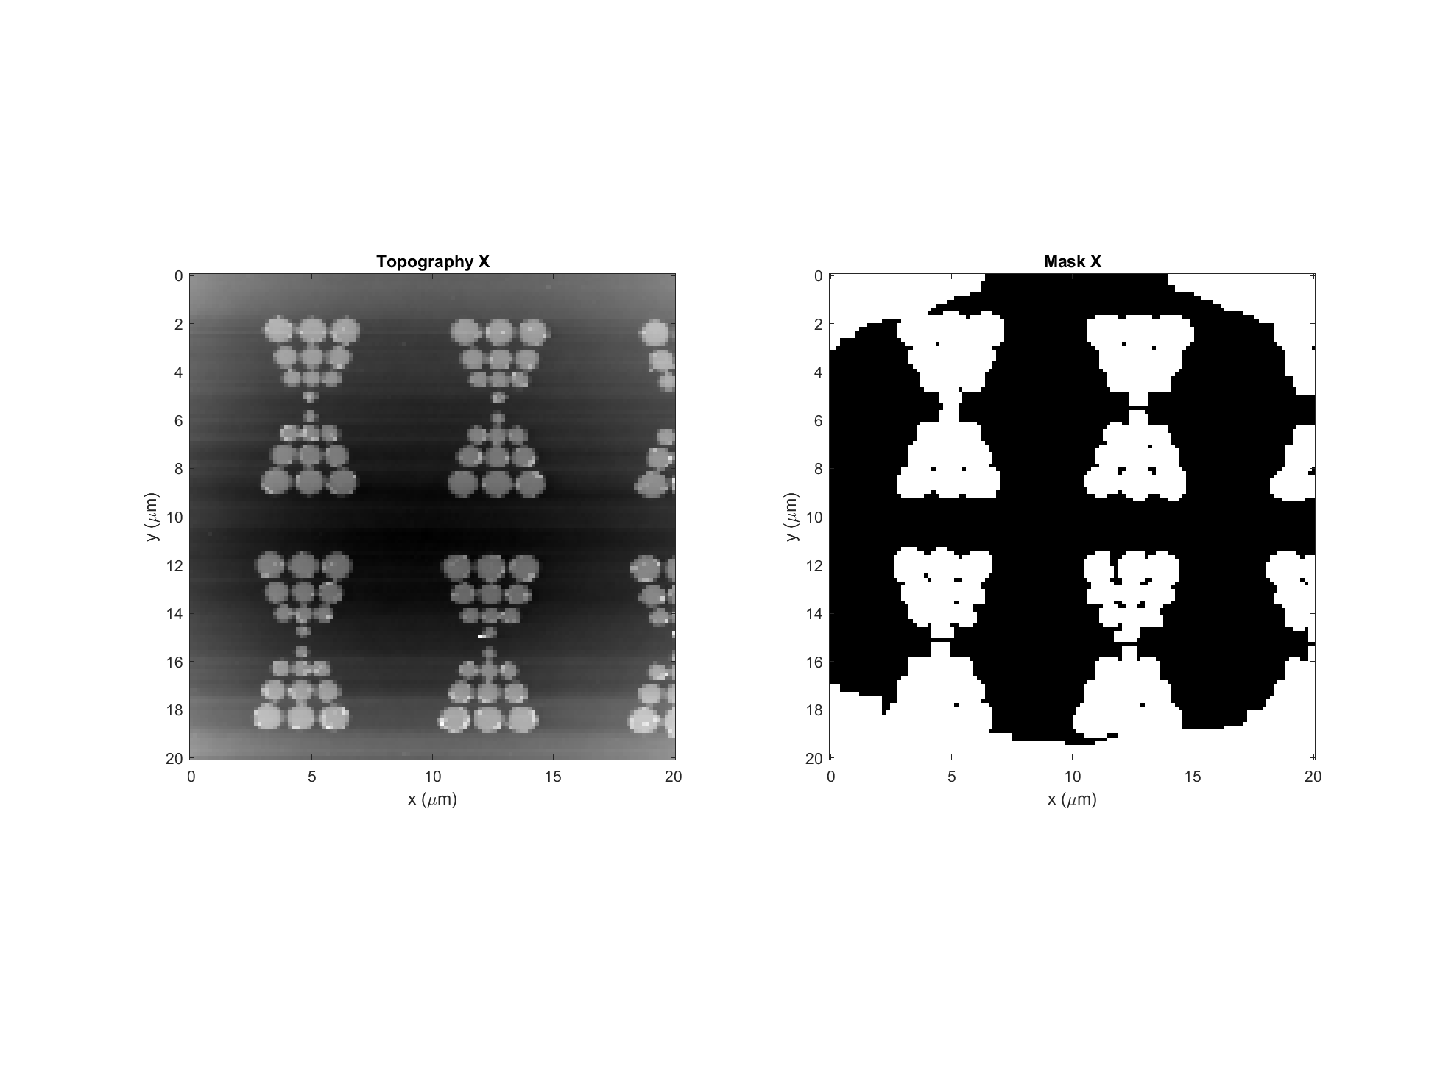
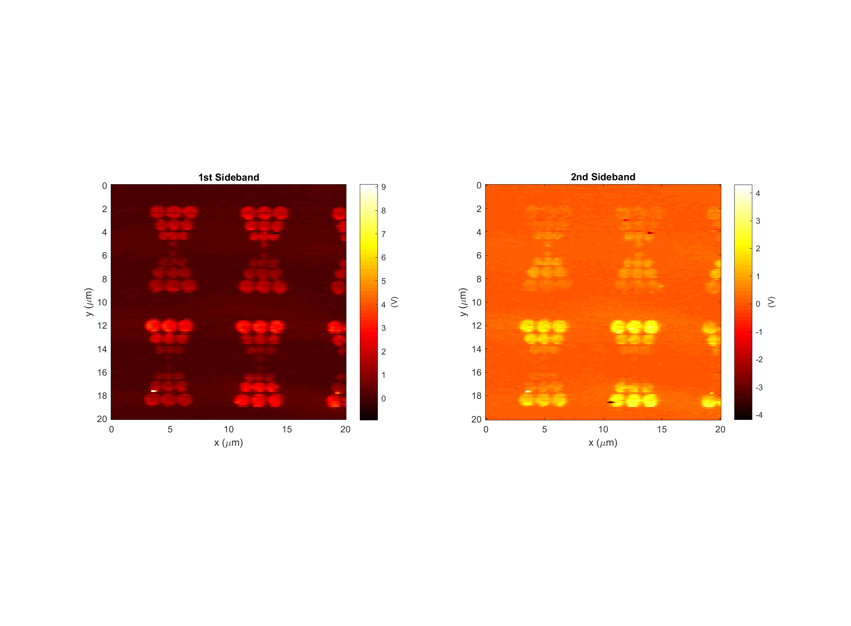
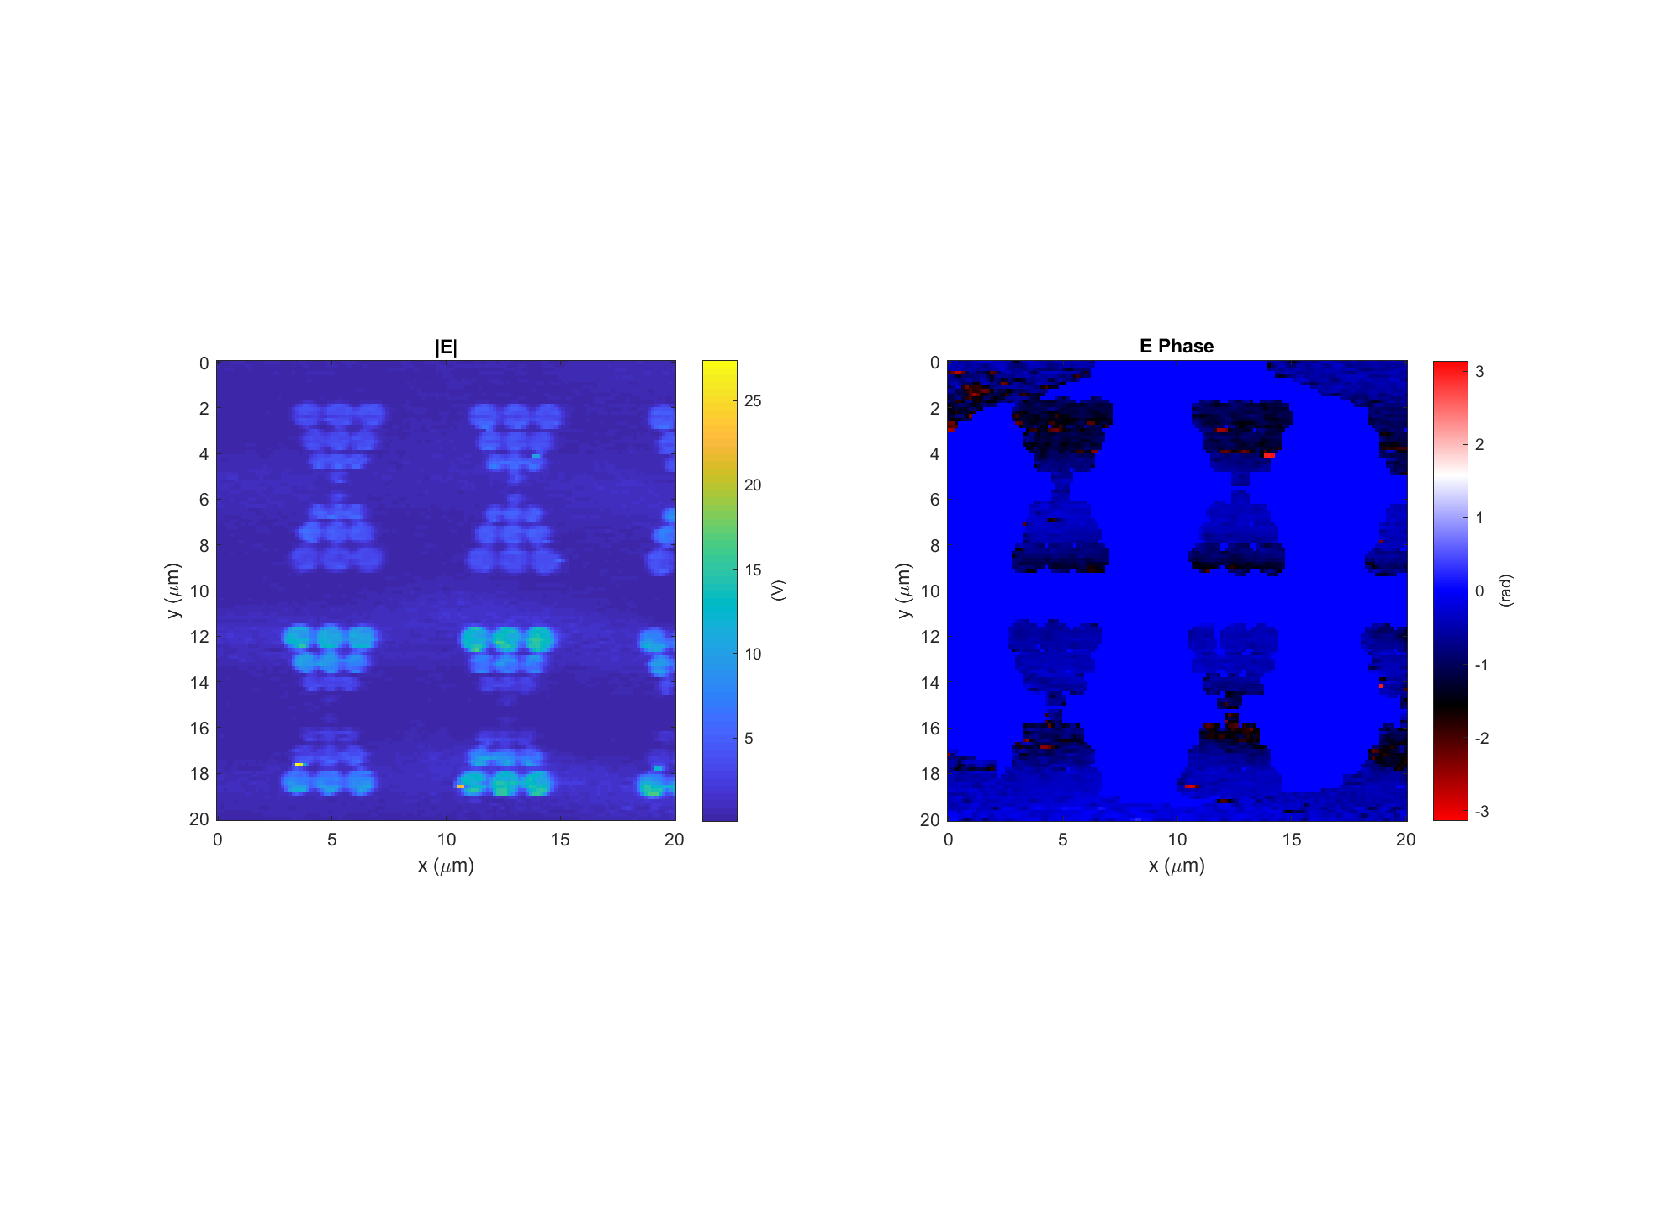
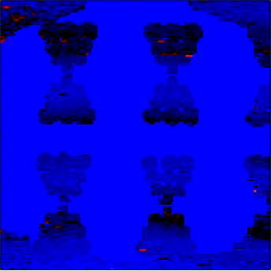
Discrete Bowtie Data: 2017-11-02_discretebowtie_1_p-pol_PH_X_4
k
Light incident from below

Slide 7
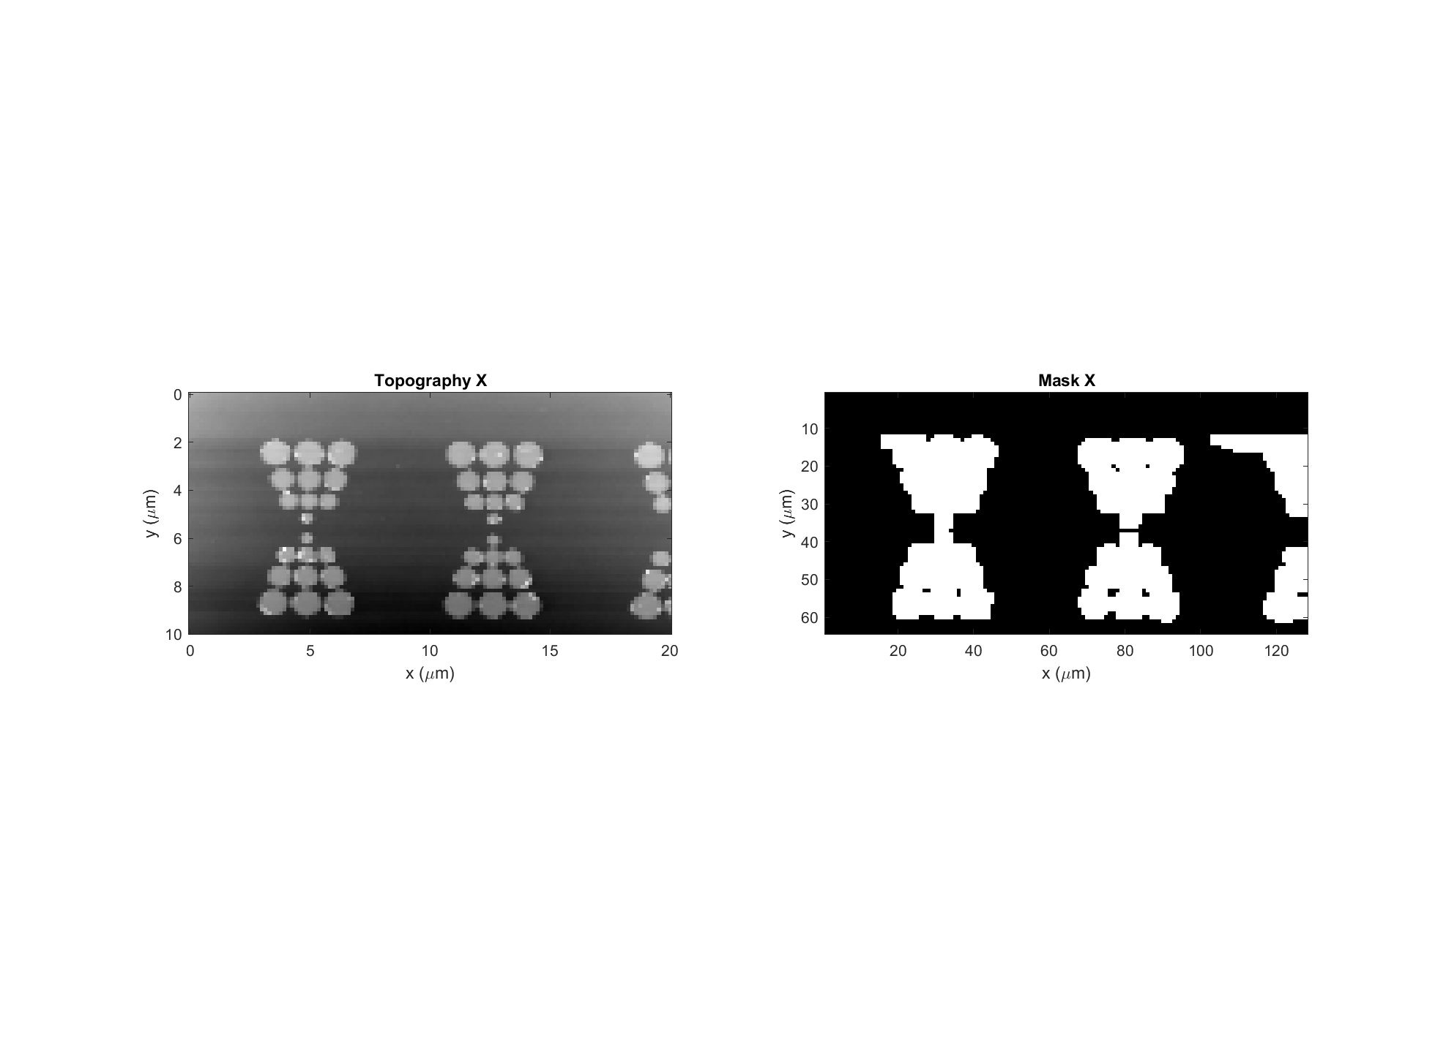
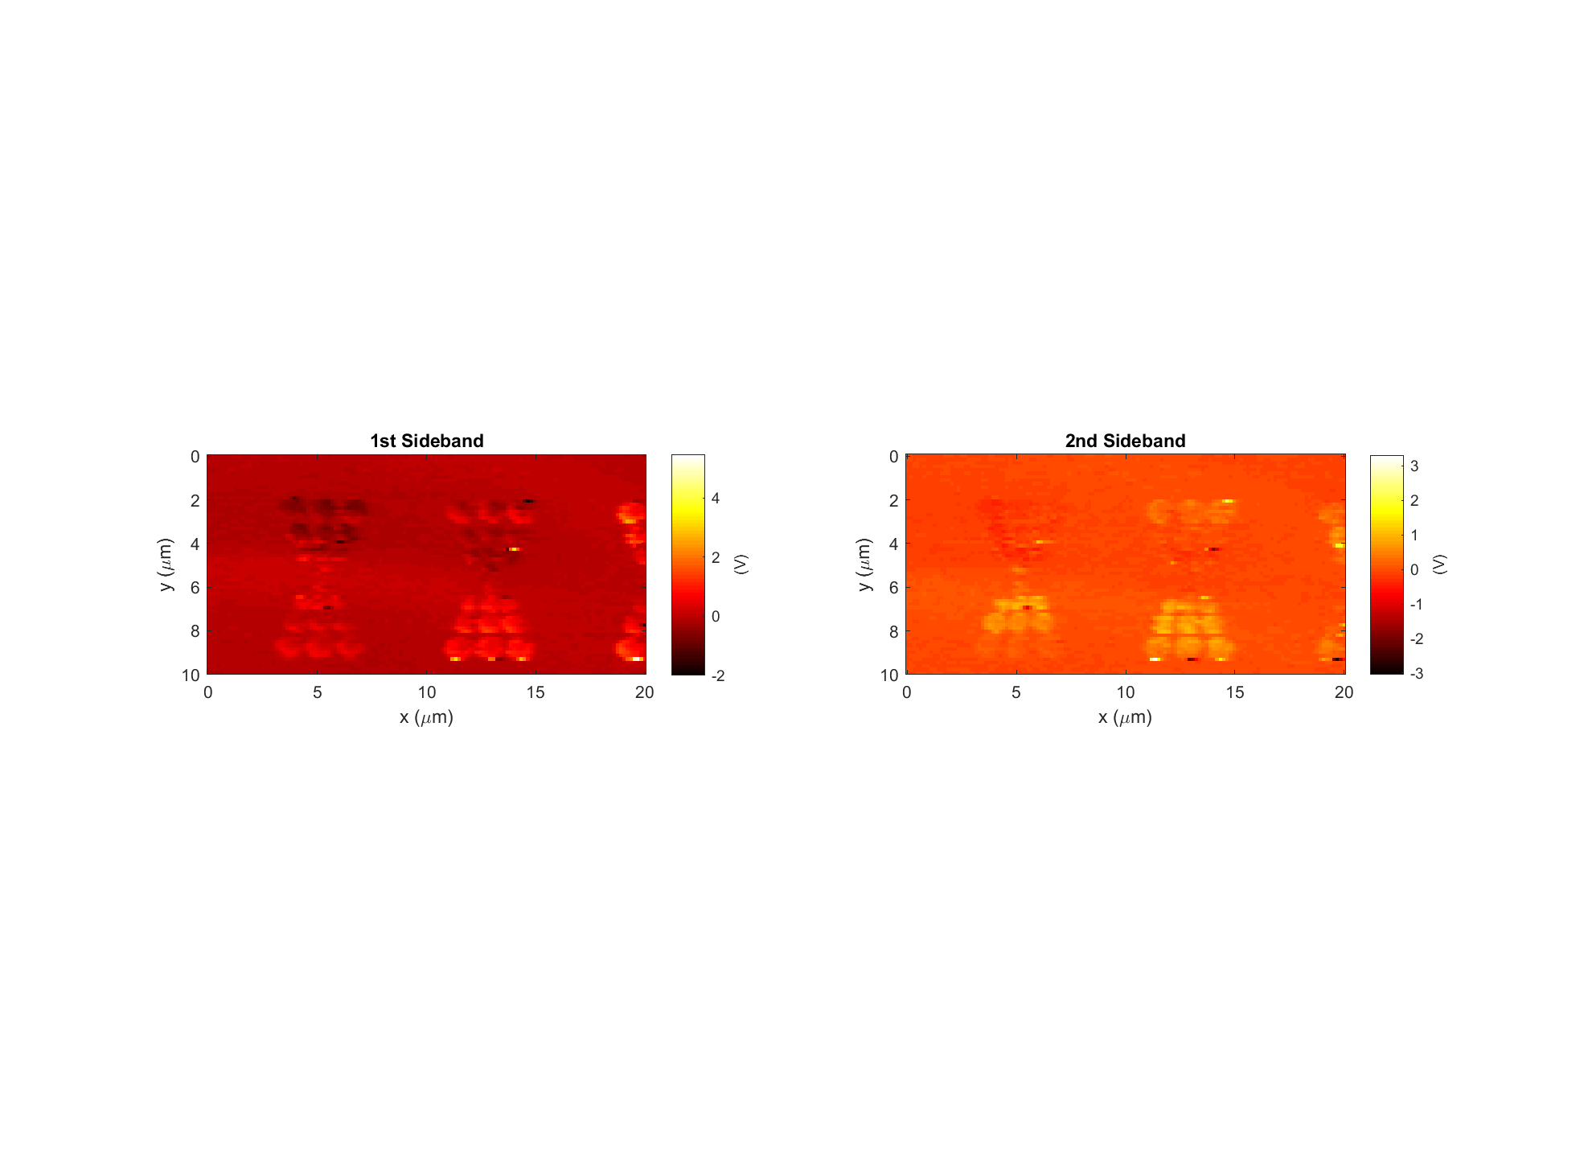
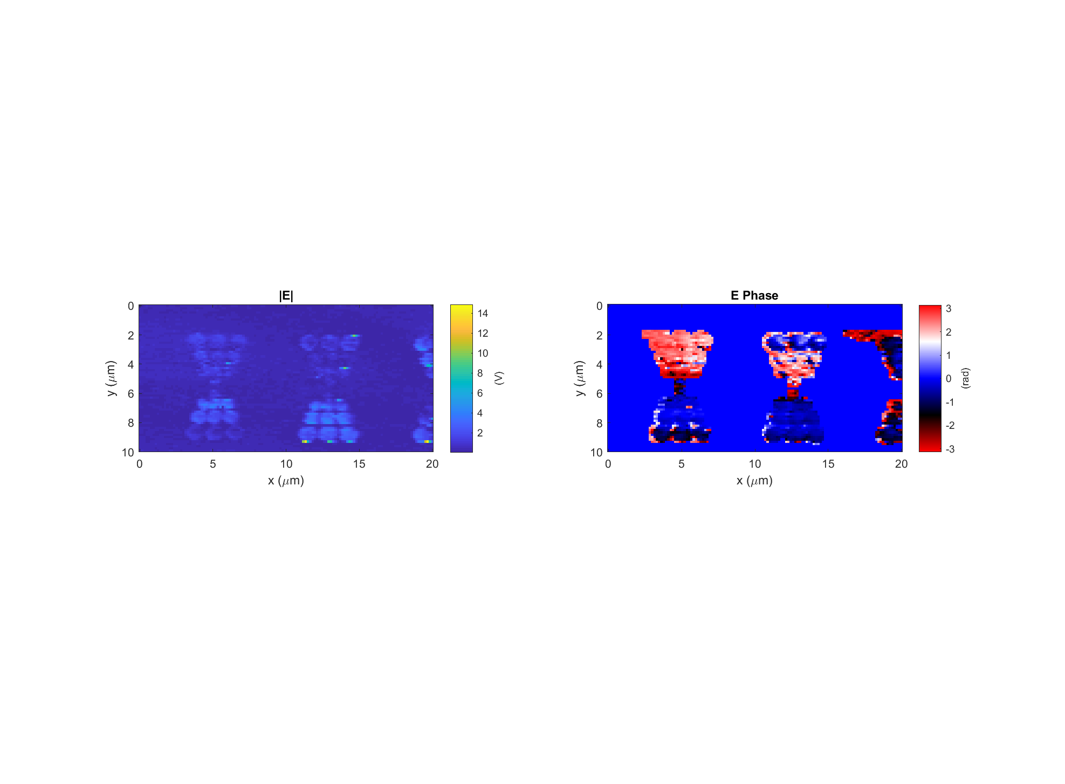
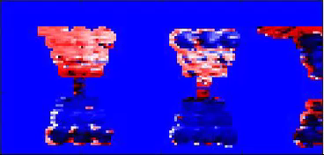
Discrete Bowtie Data: 2017-11-02_discretebowtie_1_p-pol_PH_X_3
k
Light incident from below

Slide 8
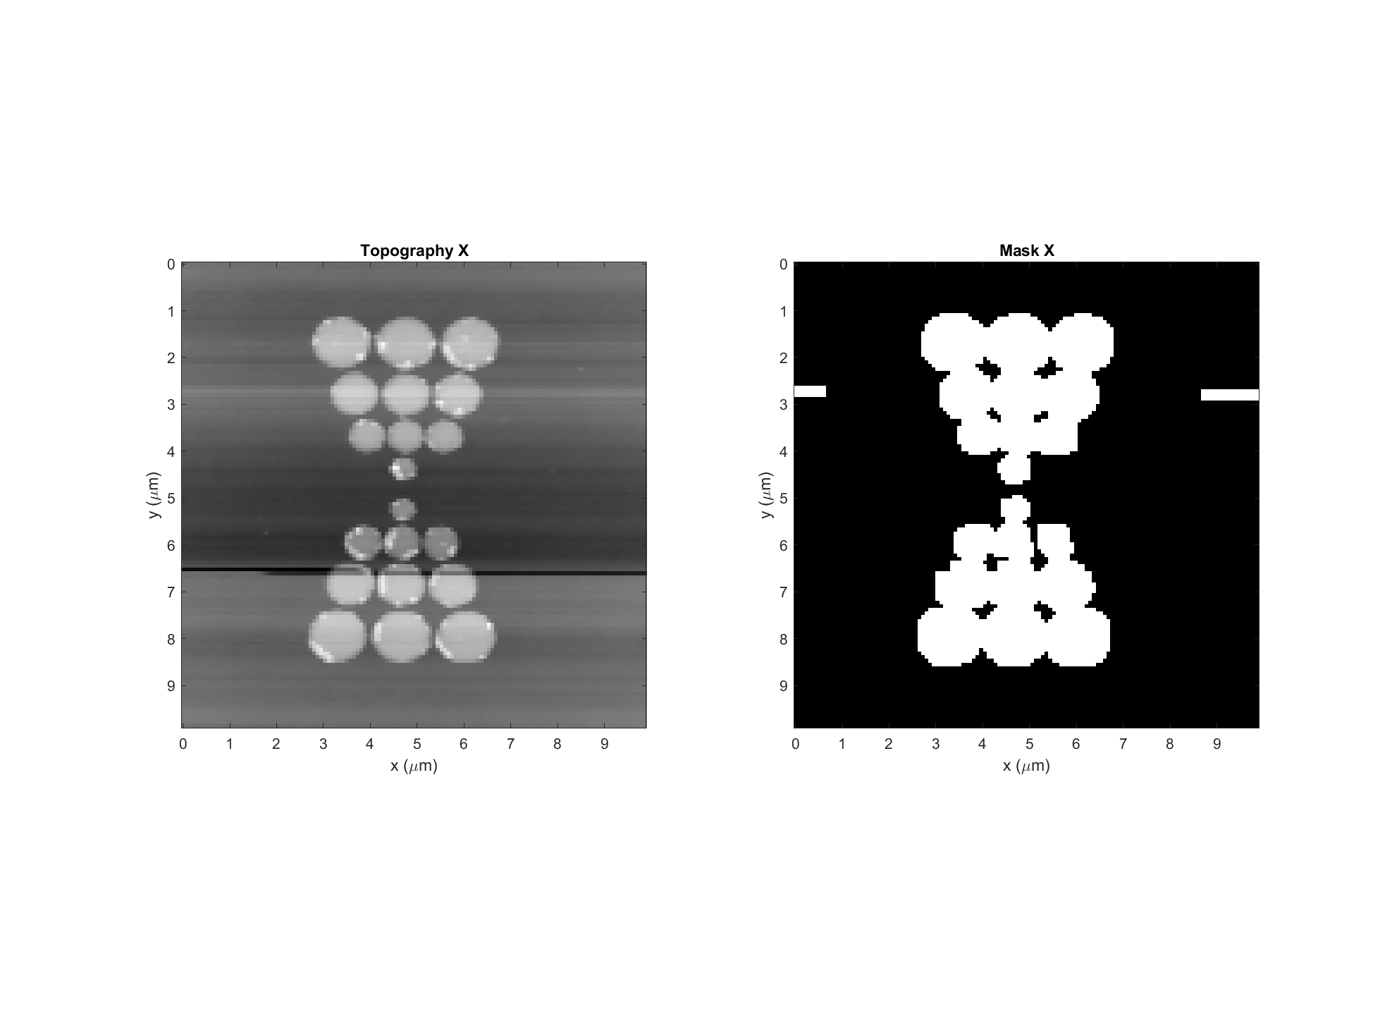
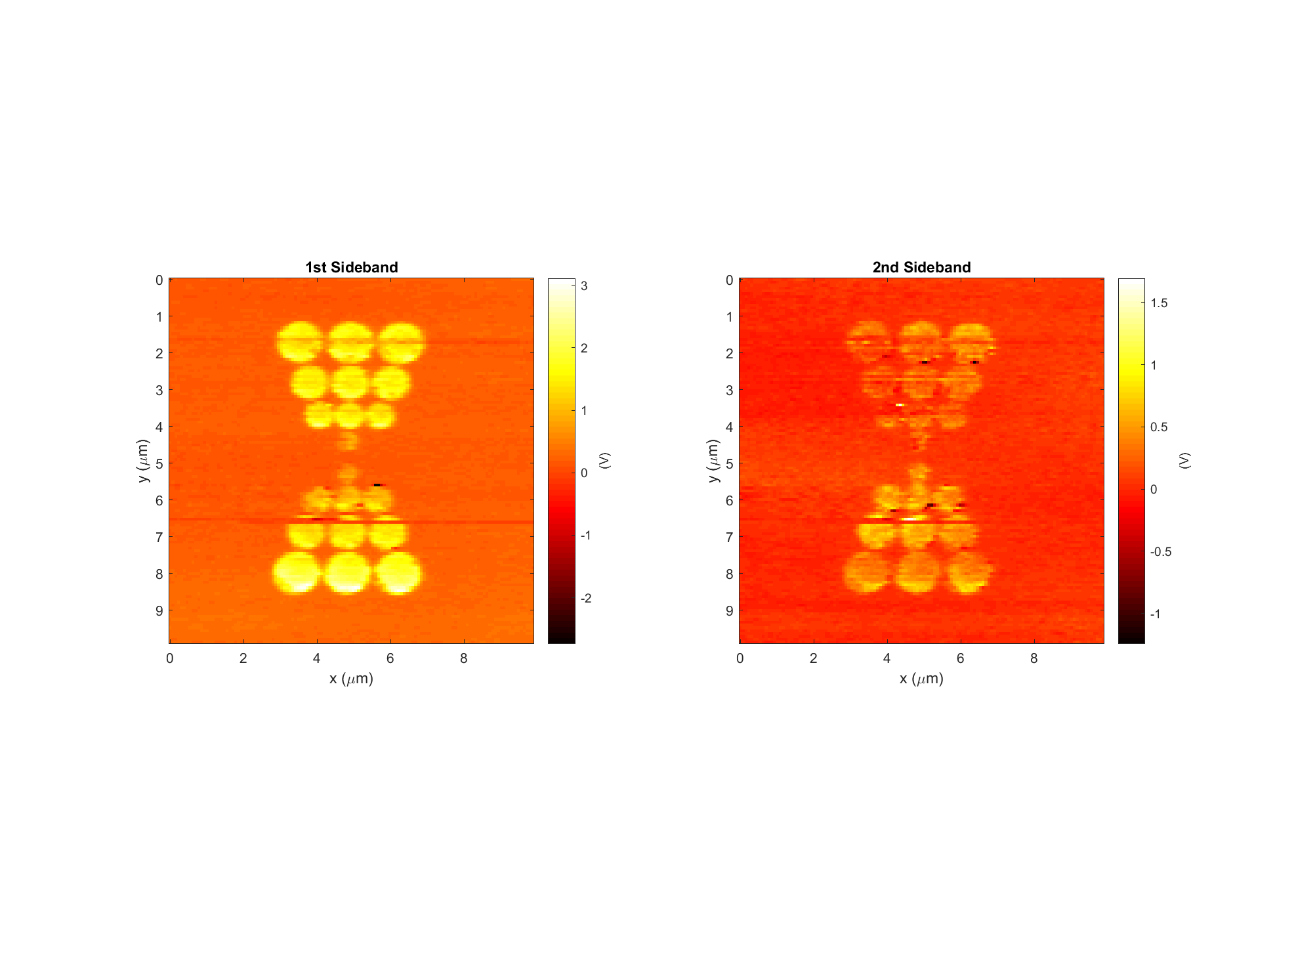
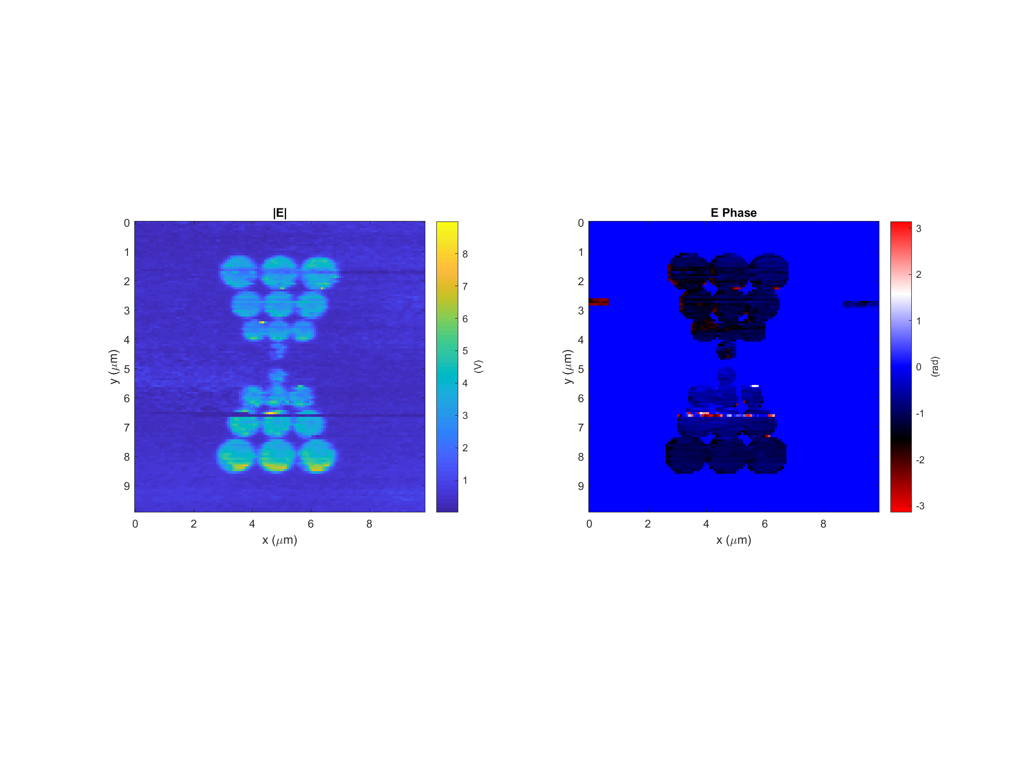
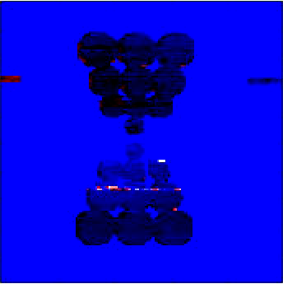
Discrete Bowtie Data: 2017-11-02_discretebowtie_1_p-pol_PH_X_5
k
Light incident from below

Slide 9
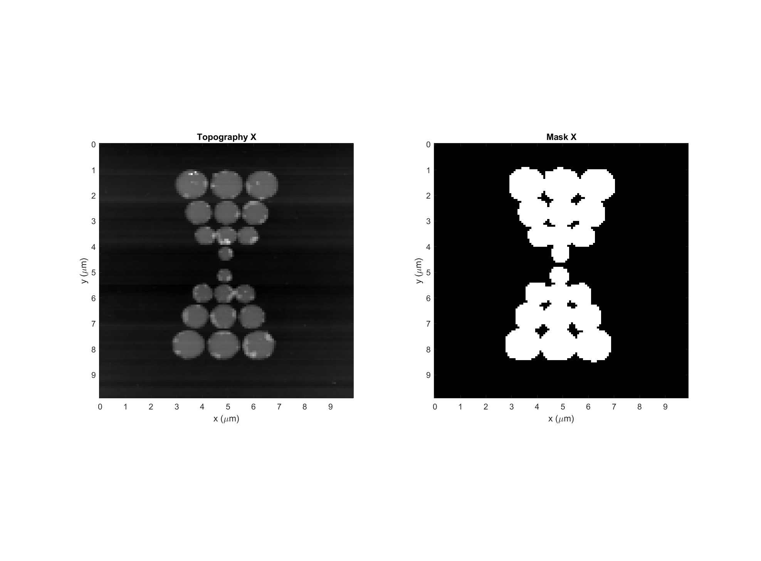
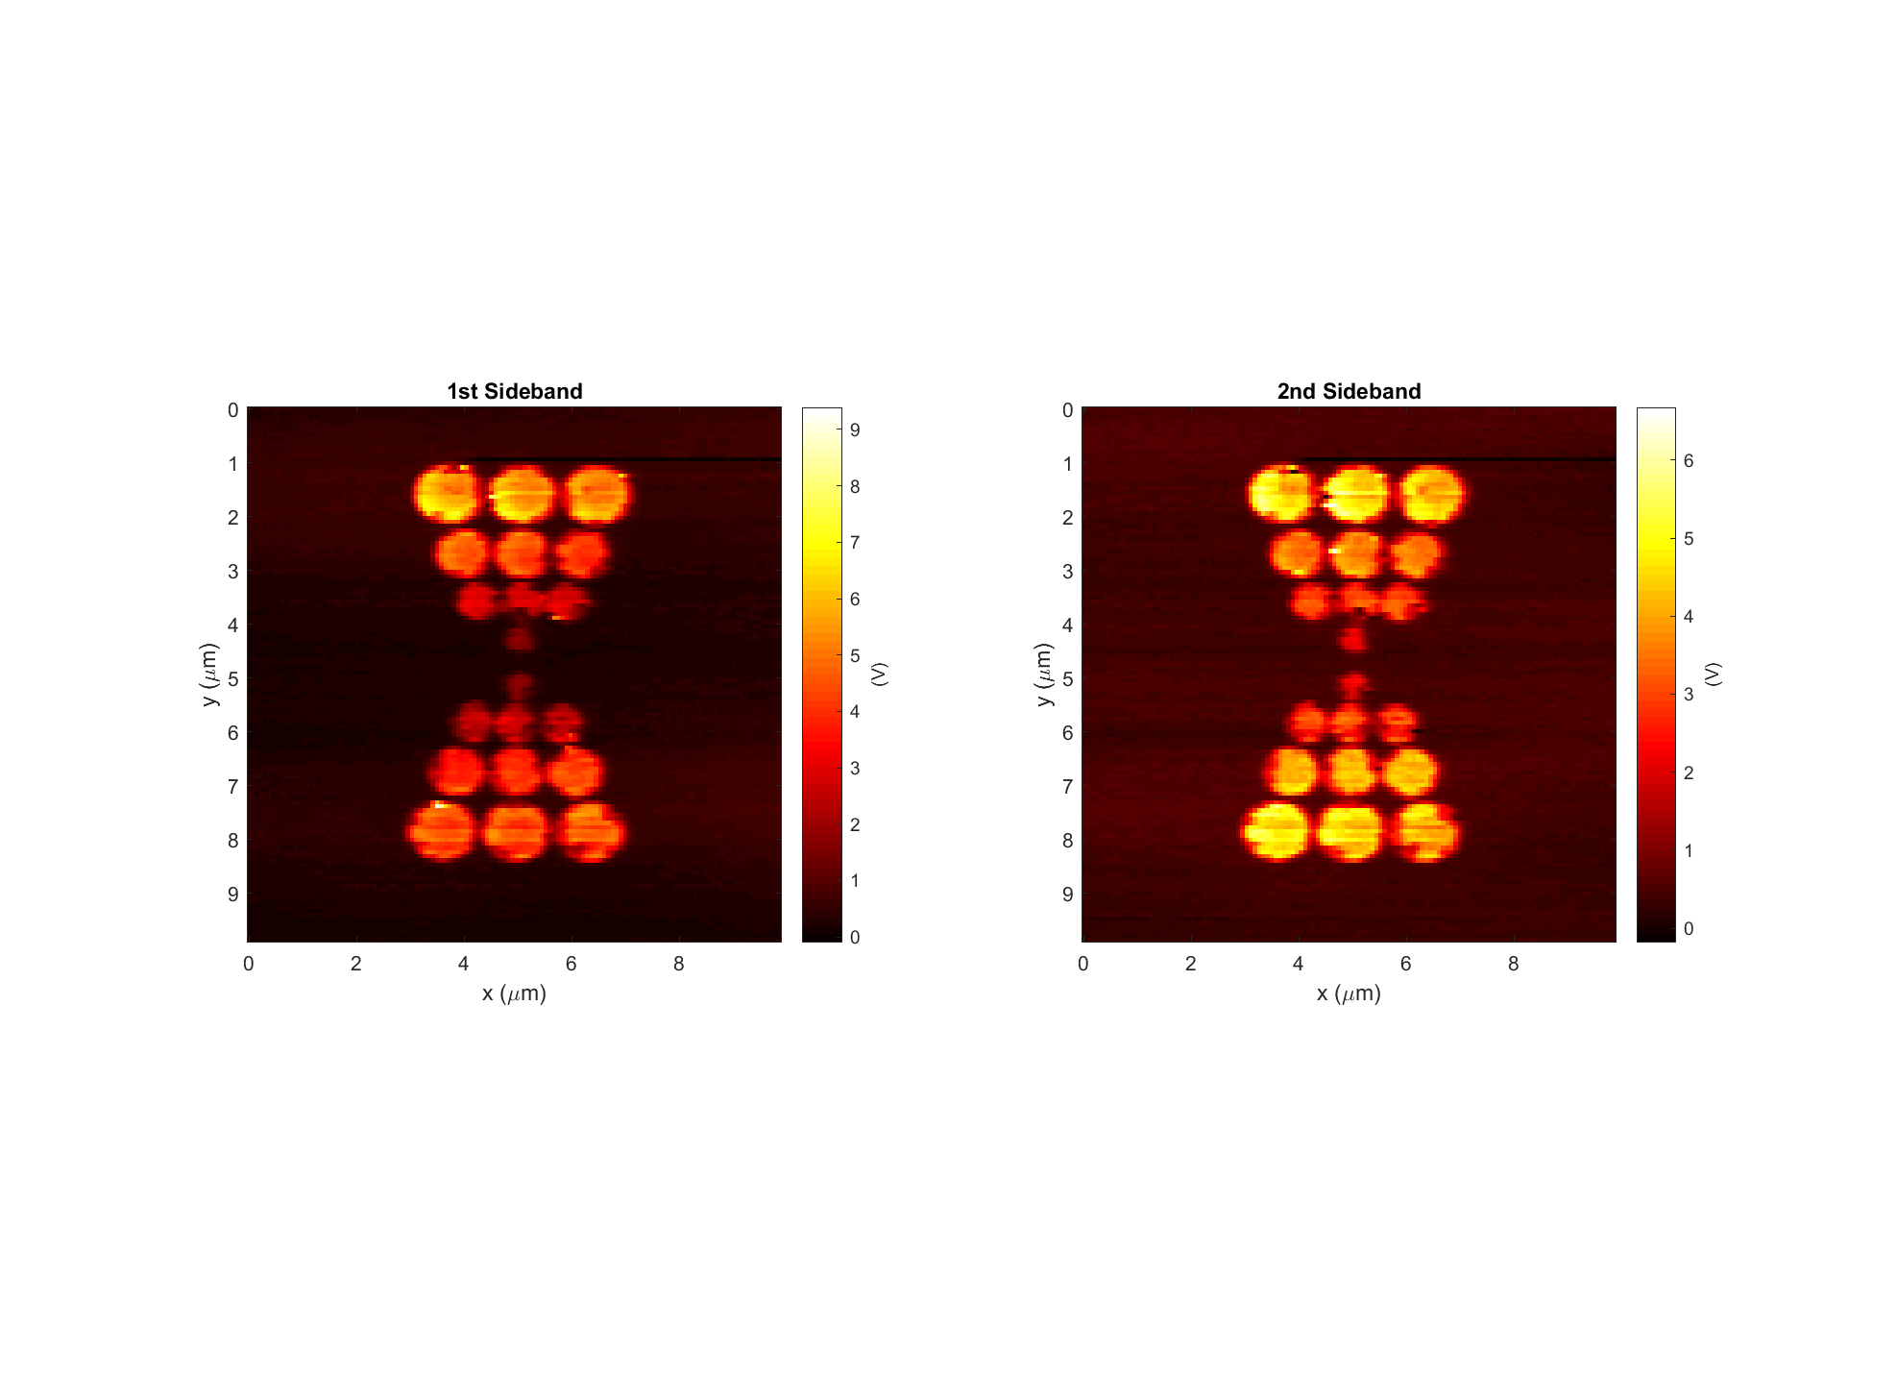
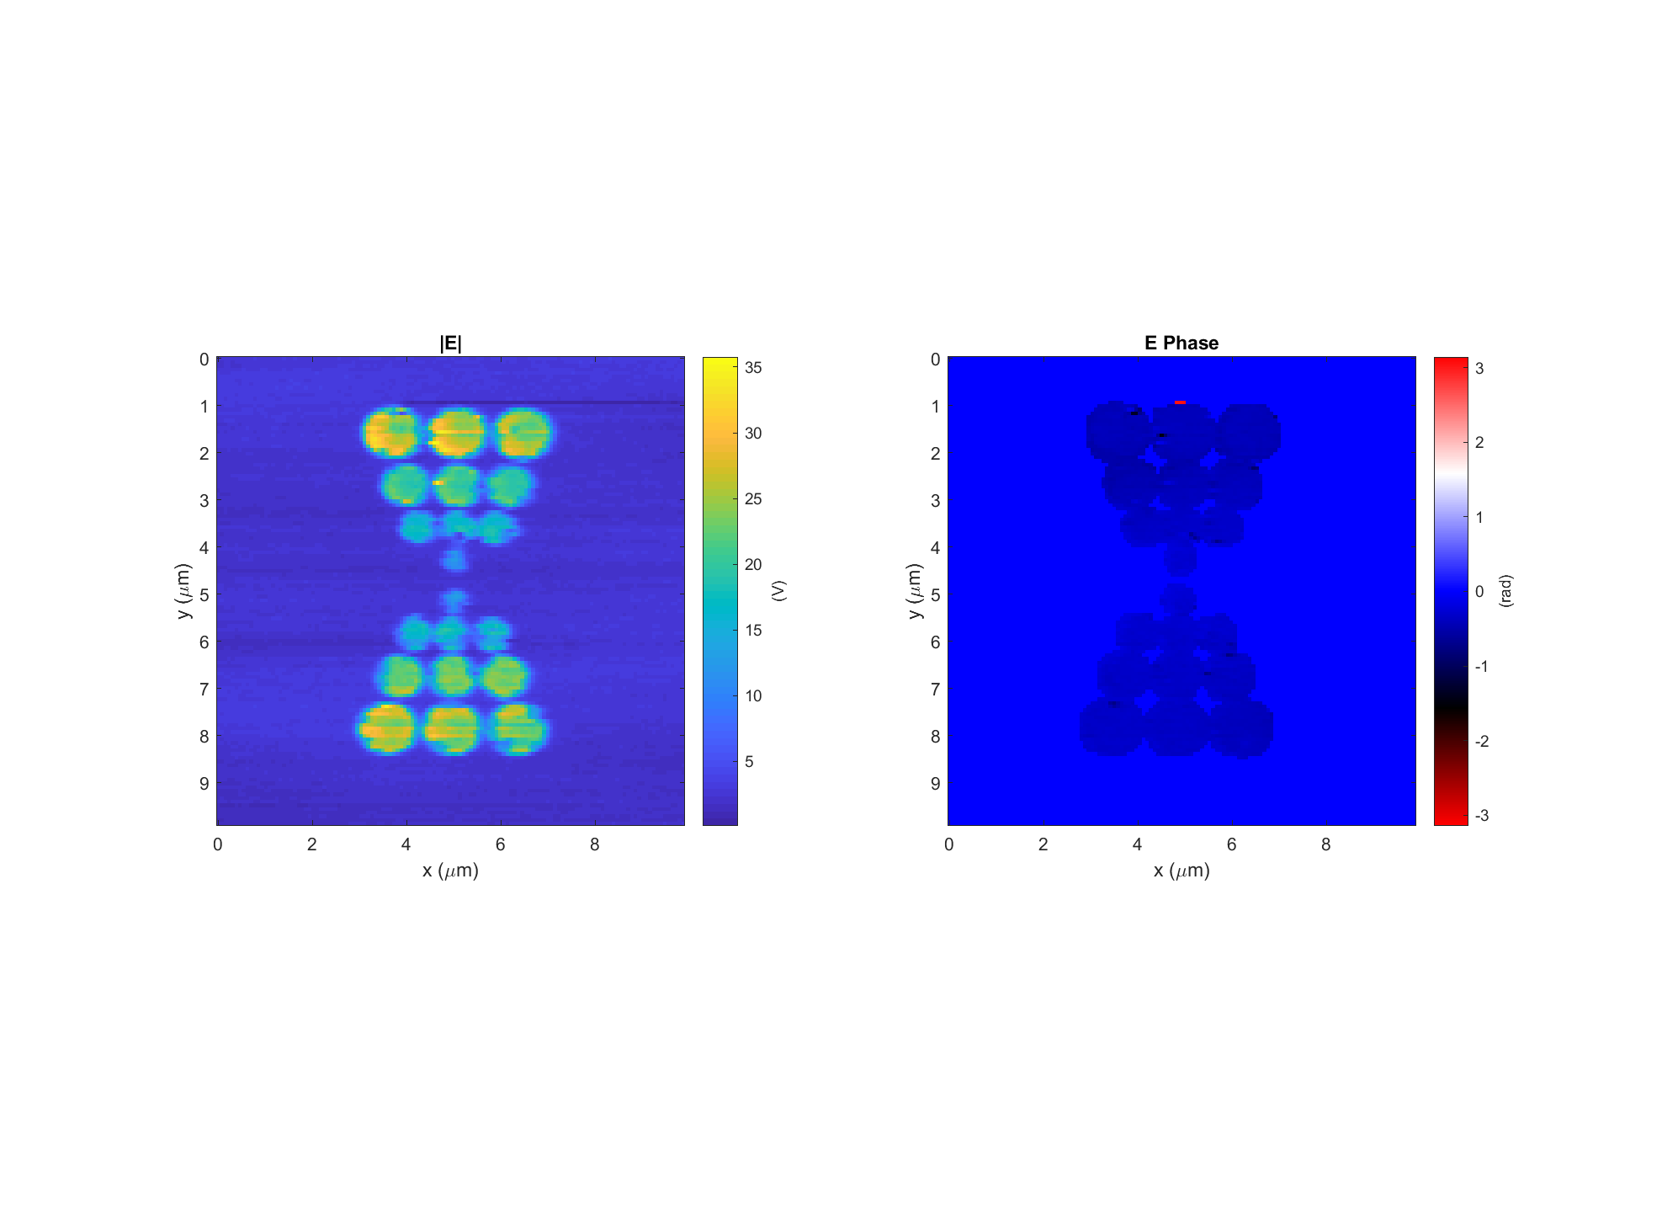
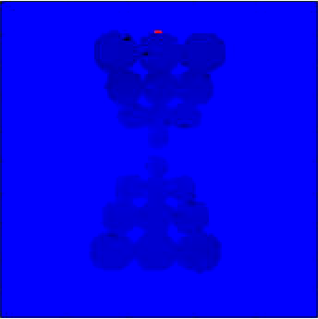
Discrete Bowtie Data: 2017-11-02_discretebowtie_1_p-pol_PH_X_2
k
Light incident from below

